Slide 1
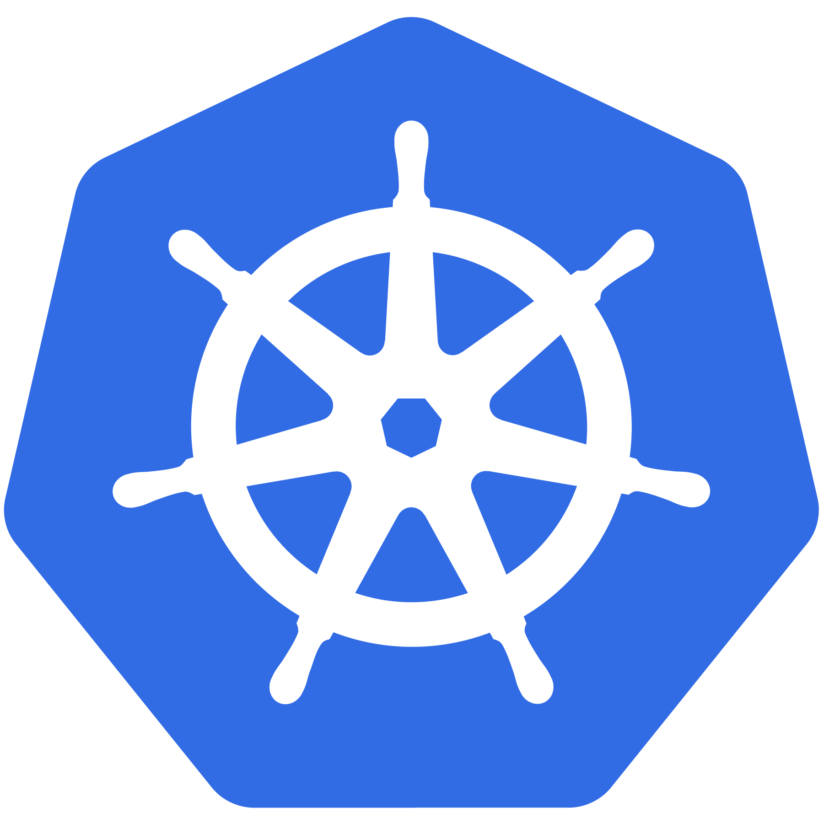
Kubernetes
An Introduction

Slide 2
Agenda
Containers
What is Kubernetes?
Architecture Overview
The Control Plane Components
Node Components

Slide 3
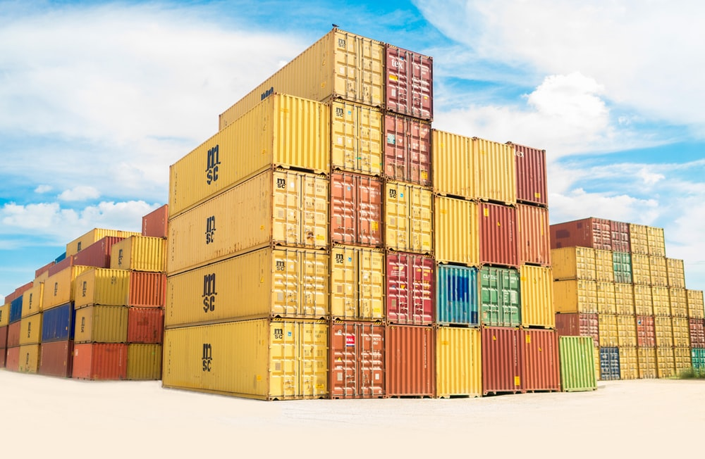
In the beginning there was Containers..

Slide 4
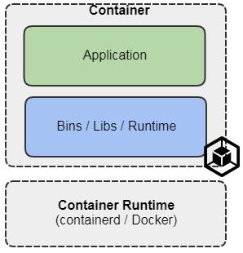
In the beginning there was Containers..
Efficient
Portable
Easy To Scale
Improved security

Slide 5
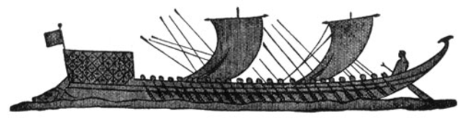
What Does “Kubernetes” Mean?
Greek for “pilot” or
“Helmsman of a ship”
Notes:
The first question always asked
There is also the abbreviation of K8s -- K, eight letters, s

Slide 6
What is Kubernetes?
A Production-Grade Container Orchestration System Google-grown, based on Borg and Omega, systems that run inside of Google right now and are proven to work at Google for over 10 years.
Extend the container goodness across nodes
Recovers automatically from failure
Basic monitoring, logging, health checking
Enables containers to find each other.
Reduce cost to run many things in production. Enables new ways of building applications.
Notes:
There’s a phrase called Google-scale. This was developed out of a need to scale large container applications across Google-scale infrastructure
borg is the man behind the curtain managing everything in google
Kubernetes is loosely coupled, meaning that all the components have little knowledge of each other and function independently.
This makes them easy to replace and integrate with a wide variety of systems

Slide 7
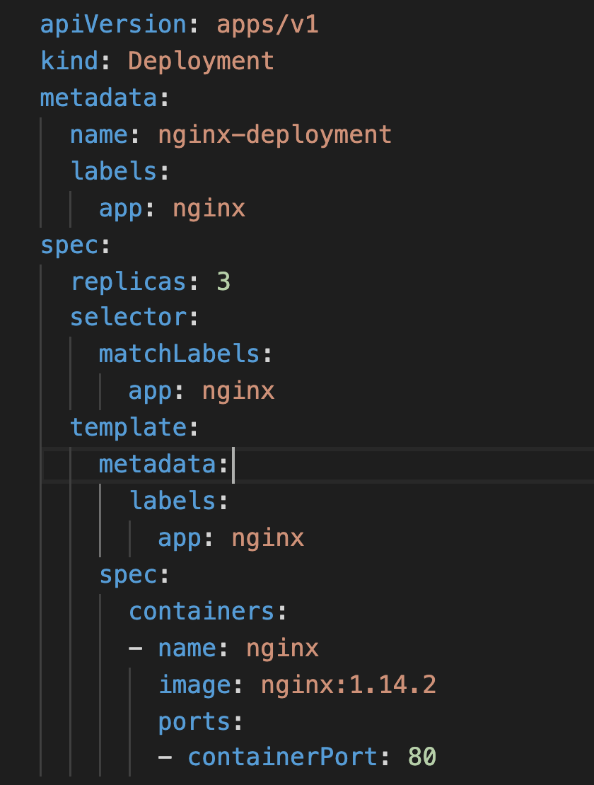
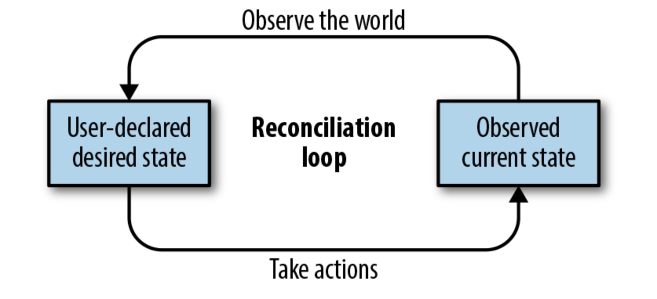
Self Healing
Notes:
The instance will have a new IP and likely be on a different host, but Kubernetes gives the primitives for us to ‘not care’ about that.

Slide 8
Self Healing
Kubernetes will ALWAYS try and steer the cluster to its desired state.
Me: “I want 3 healthy instances of redis to always be running.”
Kubernetes: “Okay, I’ll ensure there are always 3 instances up and running.”
Kubernetes: “Oh look, one has died. I’m going to attempt to spin up a new one.”
Notes:
The instance will have a new IP and likely be on a different host, but Kubernetes gives the primitives for us to ‘not care’ about that.

Slide 9
What can Kubernetes REALLY do?
Autoscale Workloads
Deployments - Roll Forwards / Rollbacks
Fire off jobs and scheduled cronjobs
Manage Stateless and Stateful Applications
Provide native methods of service discovery
Easily integrate and support 3rd party apps
Notes:
Everything here requires some level of configuration

Slide 10
Most Importantly...
Use the SAME API across bare metal and EVERY cloud provider!!!
Notes:
Single biggest value-add Kubernetes can offer

Slide 11
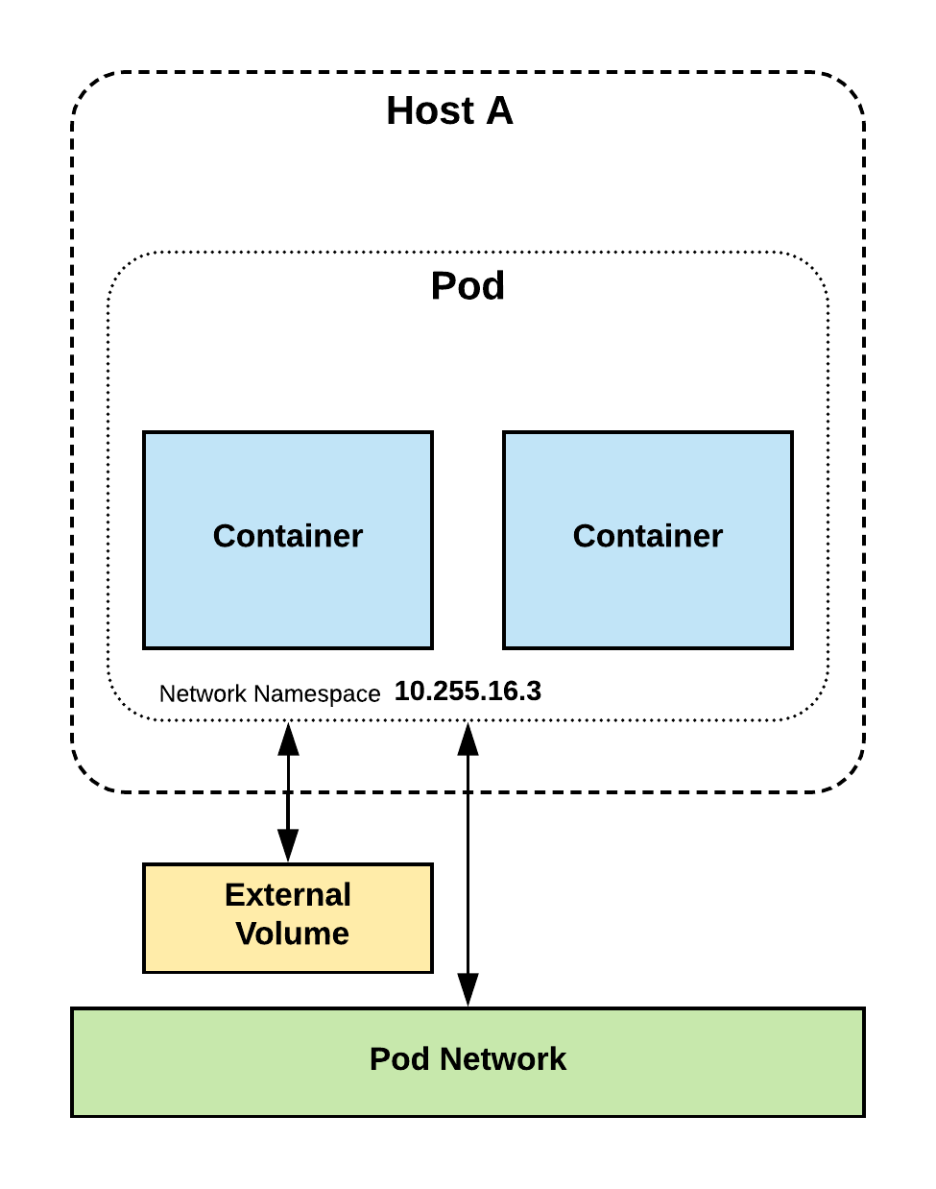
Pods
Atomic unit or smallest “unit of work”of Kubernetes.
Pods are one or MORE containers that share volumes, a network namespace, and are a part of a single context.

Slide 12
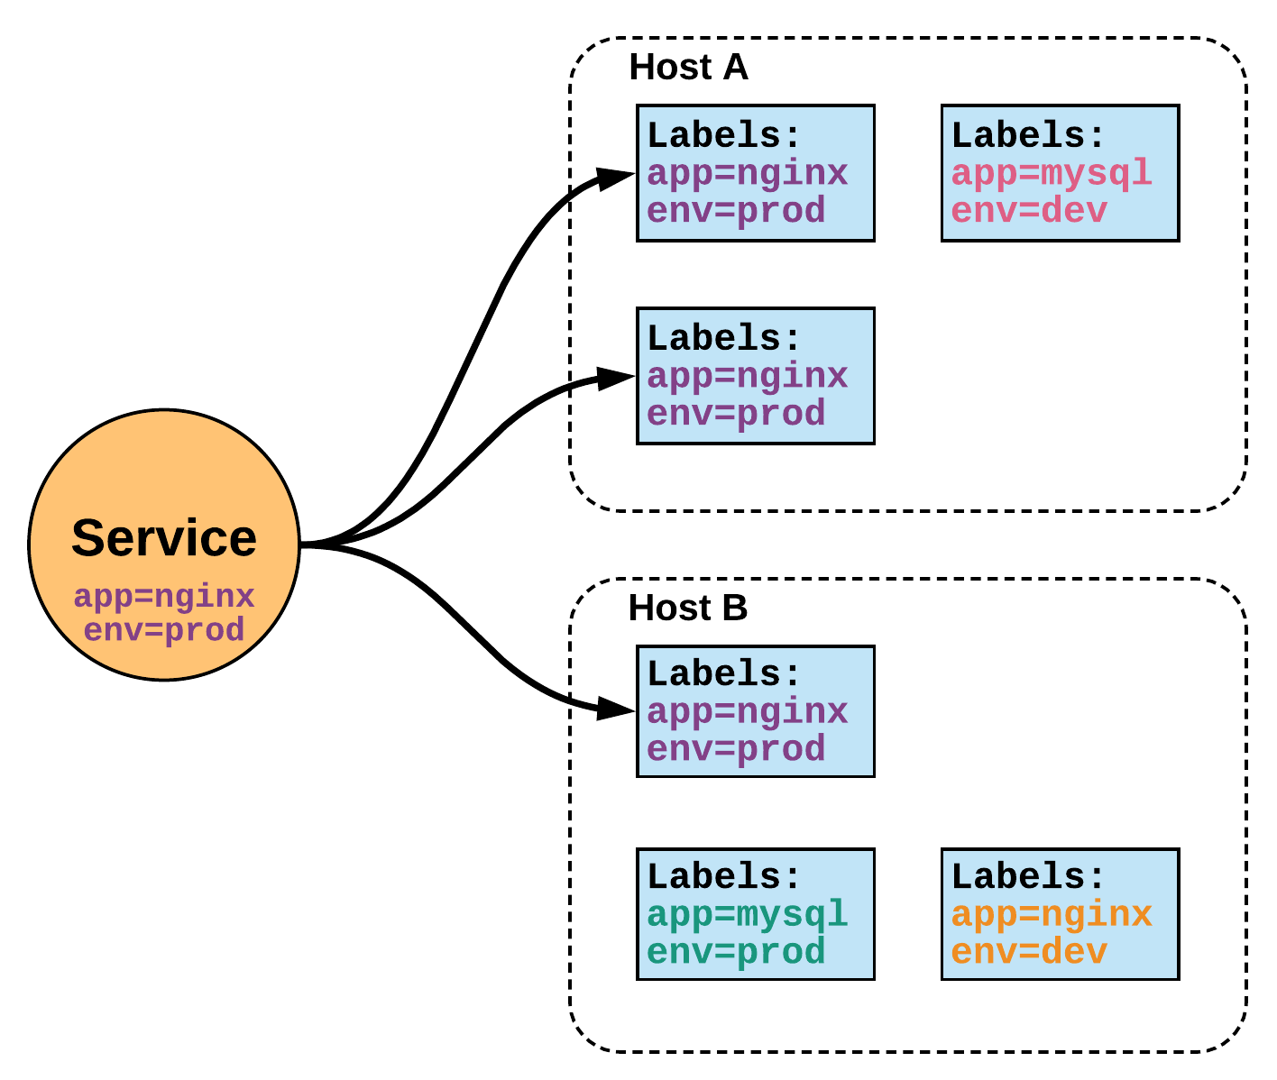
Services
Unified method of accessing the exposed workloads of Pods.
Durable resource
static cluster IP
static namespaced DNS name
Notes:
While this may seem like a technical definition, in practice it can be viewed more simply:
A service is an internal load balancer to your pod(s). You have 3 HTTP pods scheduled? Create a service, reference the pods, and (internally) it will load balance across the three.

Slide 13
Architecture
Overview
Notes:
Get right into the meat of the internals.

Slide 14
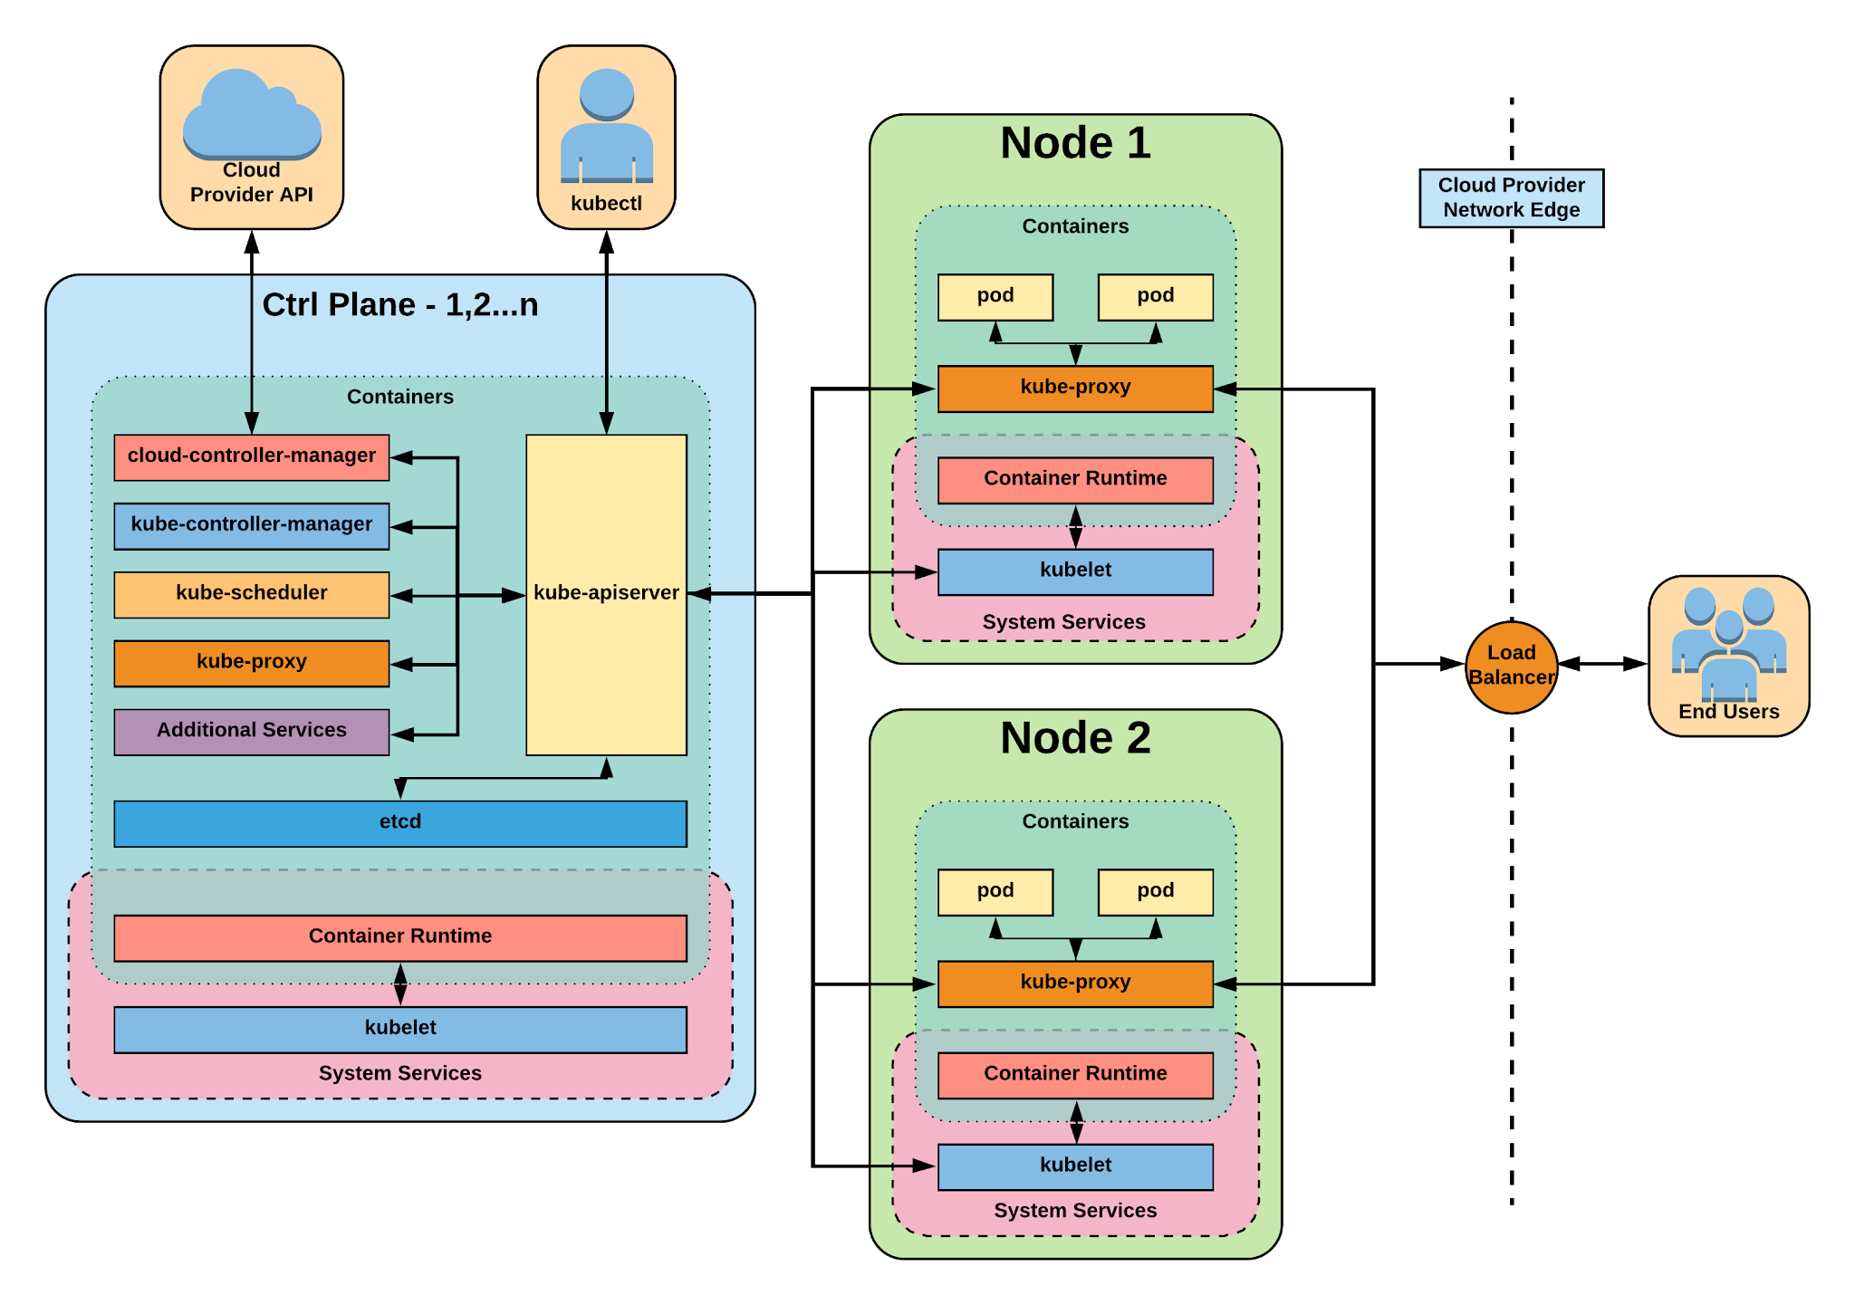
Notes:
The complete picture

Slide 15
Control Plane Components
Architecture Overview

Slide 16

Control Plane Components
kube-apiserver
etcd
kube-controller-manager
kube-scheduler
cloud-controller-manager
Notes:
Kube-apiserver
Gate keeper for everything in kubernetes
EVERYTHING interacts with kubernetes through the apiserver
Etcd
Distributed storage back end for kubernetes
The apiserver is the only thing that talks to it
Kube-controller-manager
The home of the core controllers
kube-scheduler
handes placement

Slide 17
kube-apiserver
Provides a forward facing REST interface into the kubernetes control plane and datastore.
All clients and other applications interact with kubernetes strictly through the API Server.
Acts as the gatekeeper to the cluster by handling authentication and authorization, request validation, mutation, and admission control in addition to being the front-end to the backing datastore.
Notes:
provides forward facing REST interface into k8s itself
everything, ALL components interact with each other through the api-server
handles authn, authz, request validation, mutation and admission control and serves as a generic front end to the backing datastore

Slide 18
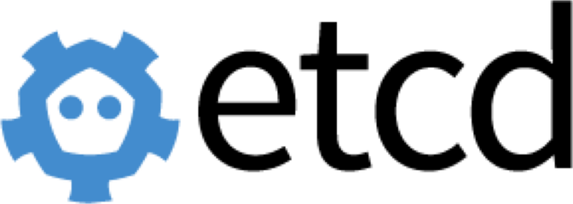
etcd
etcd acts as the cluster datastore.
Purpose in relation to Kubernetes is to provide a strong, consistent and highly available key-value store for persisting cluster state.
Stores objects and config information.
Notes:
is the backing datastore
extremely durable and highly available key-value store
was developed originally by coreos now redhat
however it is in the process of being donated to the CNCF

Slide 19
kube-controller-manager
Monitors the cluster state via the apiserver and steers the cluster towards the desired state.
Node Controller: Responsible for noticing and responding when nodes go down.
Replication Controller: Responsible for maintaining the correct number of pods for every replication controller object in the system.
Endpoints Controller: Populates the Endpoints object (that is, joins Services & Pods).
Service Account & Token Controllers: Create default accounts and API access tokens for new namespaces.
Notes:
Its the director behind the scenes
The thing that says “hey I need a few more pods spun up”
Does NOT handle scheduling, just decides what the desired state of the cluster should look like
e.g. receives request for a deployment, produces replicaset, then produces pods

Slide 20
kube-scheduler
Component on the master that watches newly created pods that have no node assigned, and selects a node for them to run on.
Factors taken into account for scheduling decisions include individual and collective resource requirements, hardware/software/policy constraints, affinity and anti-affinity specifications, data locality, inter-workload interference and deadlines.
Notes:
scheduler decides which nodes should run which pods
updates pod with a node assignment, nodes poll checking which pods have their matching assignment
takes into account variety of reqs, affinity, anti-affinity, hw resources etc
possible to actually run more than one scheduler
example: kube-batch is a gang scheduler based off LSF/Symphony from IBM

Slide 21
cloud-controller-manager
Node Controller: For checking the cloud provider to determine if a node has been deleted in the cloud after it stops responding
Route Controller: For setting up routes in the underlying cloud infrastructure
Service Controller: For creating, updating and deleting cloud provider load balancer
Volume Controller: For creating, attaching, and mounting volumes, and interacting with the cloud provider to orchestrate volumes
Notes:
Its the director behind the scenes
The thing that says “hey I need a few more pods spun up”
Does NOT handle scheduling, just decides what the desired state of the cluster should look like
e.g. receives request for a deployment, produces replicaset, then produces pods

Slide 22
Node
Components
Architecture Overview

Slide 23
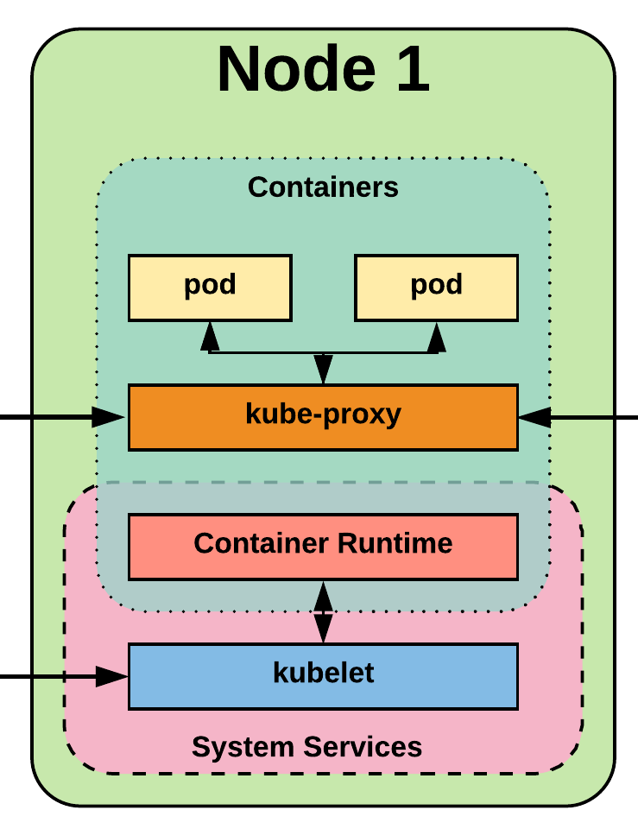
Node Components
kubelet
kube-proxy
Container Runtime Engine
Notes:
Kubelet
Agent running on every node, including the control plane
Kube-proxy
The network ‘plumber’ for Kubernetes services
Enables in-cluster load-balancing and service discovery
Container Runtime Engine
The containerizer itself - typically docker

Slide 24
kubelet
An agent that runs on each node in the cluster. It makes sure that containers are running in a pod.
The kubelet takes a set of PodSpecs that are provided through various mechanisms and ensures that the containers described in those PodSpecs are running and healthy.
Notes:
the single host daemon required for a being a part of a kubernetes cluster
can read pod manifests from several different locations
workers: poll kube-apiserver looking for what they should run
masters: run the master services as static manifests found locally on the host

Slide 25
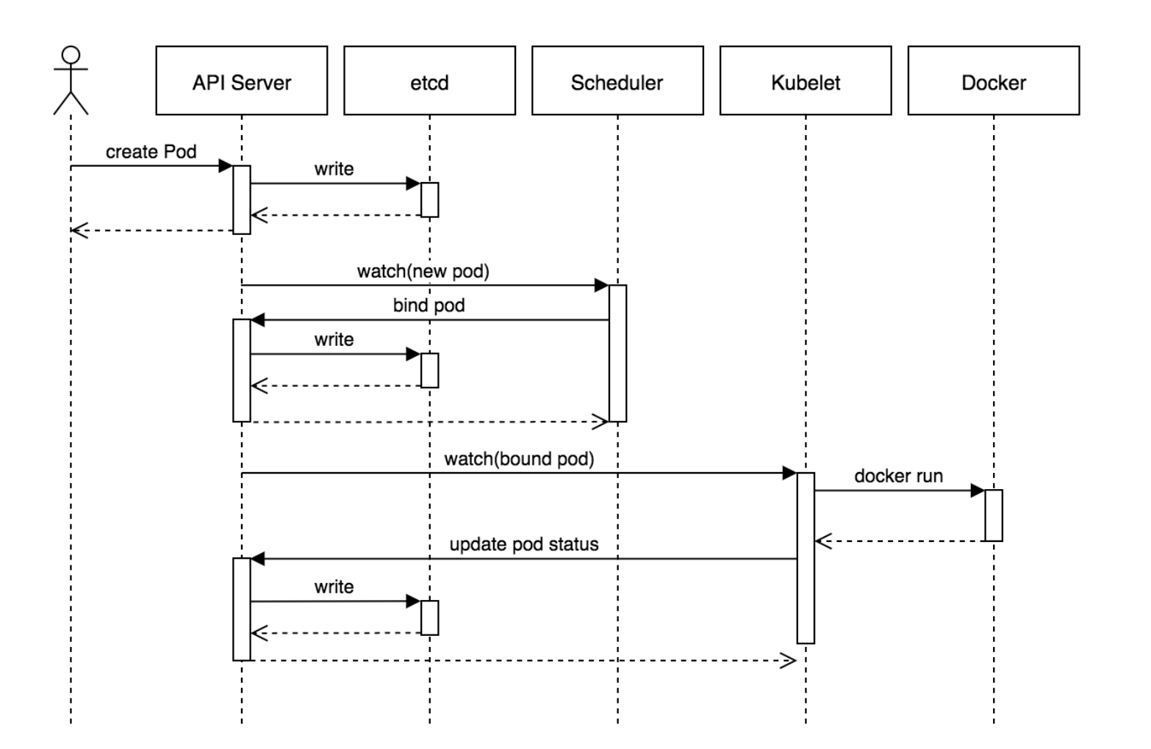
Notes:
It then scales up the new ReplicaSet based on our maxSurge value

Slide 26
kube-proxy
Manages the network rules on each node.
Performs connection forwarding or load balancing for Kubernetes cluster services.
Notes:
kube-proxy is the plumber
creates the rules on the host to map and expose services
uses a combination of ipvs and iptables to manage networking/loadbalancing
ipvs is more performant and opens the door to a wider feature set (port ranges, better lb rules etc)

Slide 27
Container Runtime Engine
A container runtime is a CRI (Container Runtime Interface) compatible application that executes and manages containers.
Containerd (docker)
Cri-o
Rkt
Kata (formerly clear and hyper)
Virtlet (VM CRI compatible runtime)
Notes:
Kubernetes functions with multiple different containerizers
Interacts with them through the CRI - container runtime interface
CRI creates a ‘shim’ to talk between kubelet and the container runtime
cri-o is a cool one that allows you to run any oci compatible image/runtime in Kubernetes
kata is a super lightweight KVM wrapper

Slide 28
Thank You

